Slide 1

Phoenix Global Student Training Insights Case
Team Name: smusab9152
Member: Musab Shaikh | Pranav Patel | Dhruvi Patel
Institution: Jai Hind College
Phoenix Global
A One-stop Career Catalyst

Slide 2

Phoenix Global Student Training Insights Case
Problem Statement:
Phoenix Global is a an award winning skill-development company helping students to acquire professional and soft skills. It is approached by a top management institute ABC Business School. ABC business school has provided its student data.
As an analytics consultant, you need to synthesize this data and present meaningful dashboards to Phoenix Global Training Programs Designing Team, to help them understand what are the various interesting facts about the batch and how are they supposed to tailor-make the program accordingly.
Data Exploration:
The dataset comprises of 896 rows of student details which included educational history, details of students MBA academic performance and Major and Minor Specialization.
Understanding the data via Python, specifically Pandas library, to explore the column values, summary statistics, data types, null values and duplicates.
Data cleaning and wrangling (Excel):
Converting Work Experience from Months to years and creating a range format as well.
Combine graduation degrees into fields and stored in a column titled Graduation Field.
Converting CGPA into rounded values, creating age and CGPA ranges for the same.
Formatting the values in language field.
Creating an aggregate percentage field which has the mean score of a student across their academic journey, and conversion into ranged values as well.
Please find the updated dataset attached in the excel image (Link):
Please also find the notebooks which contains data cleaning and analysis: (Link)

Slide 3
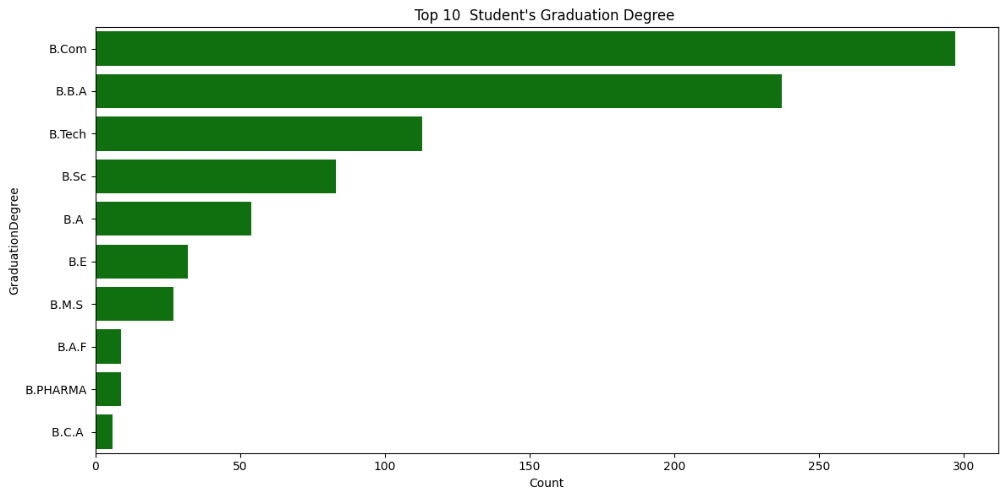
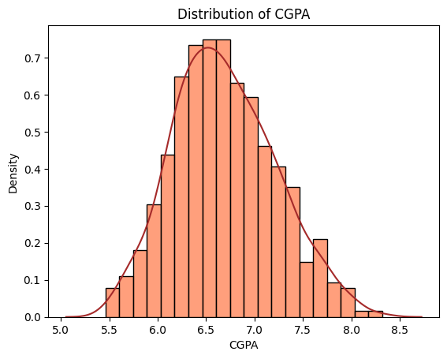
Phoenix Global Student Training Insights Case
Visualization and Insights (Student Demographic)
The CGPA distribution is approximately normal, with the majority of students scoring between 6.5 and 7.5 CGPA.
Commerce and business-related degrees dominate the student population, showing a strong preference for career paths in business, management, and finance. Technical degrees like B.Tech also have a significant share, indicating interest in technology-focused roles.

Slide 4
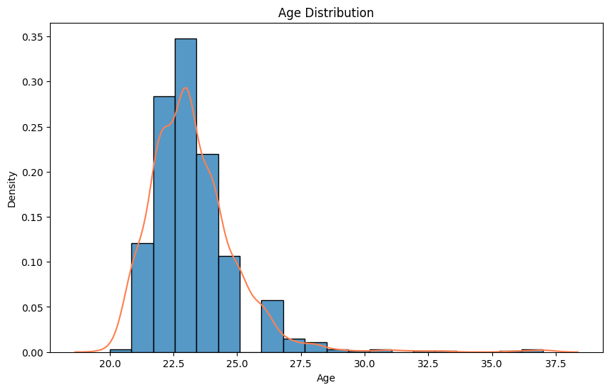
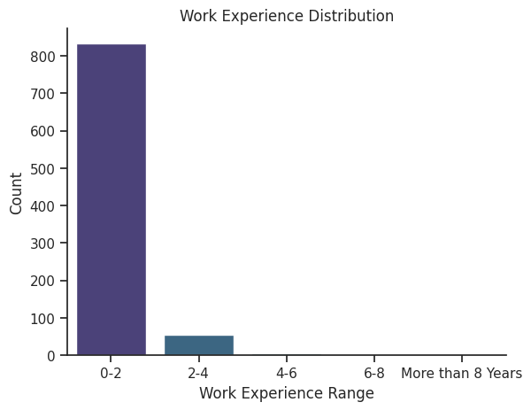
Phoenix Global Student Training Insights Case
Visualization and Insights (Student Demographic)
The majority of age range of students are in between 22-25 years old with density of 0.35 of the data.
Over 800 individuals have 0-2 years of experience with small group belonging to 2-4 work experience category and almost negligible students have more than 4 years of work experience

Slide 5
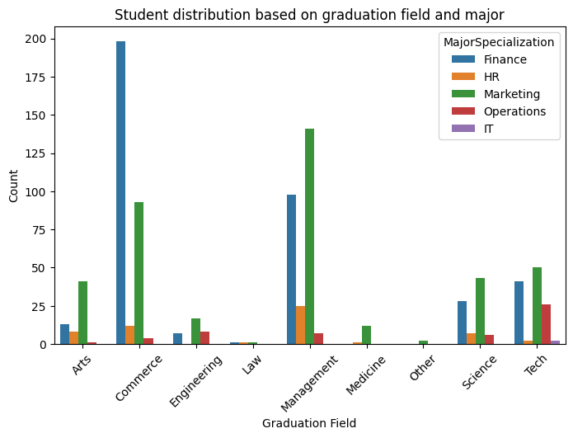
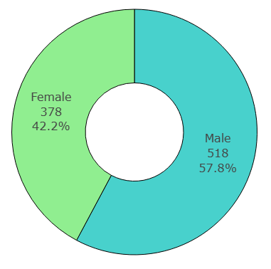
Phoenix Global Student Training Insights Case
Visualization and Insights (Program Demographic)
Gender Distribution
The pie chart indicates that 57.8% of the students are male, numbering 518 out of 896, and females make up 42.2% of the batch.
The bar chart above indicates the popularity of selected majors among students, graduated in various fields.
Commerce, Management contribute heavily to the pursuants, followed by Science and Tech. Students from other fields only represent a small subset of the total populace
Finance and Marketing are the sought after majors, followed by Operations and HR.

Slide 6
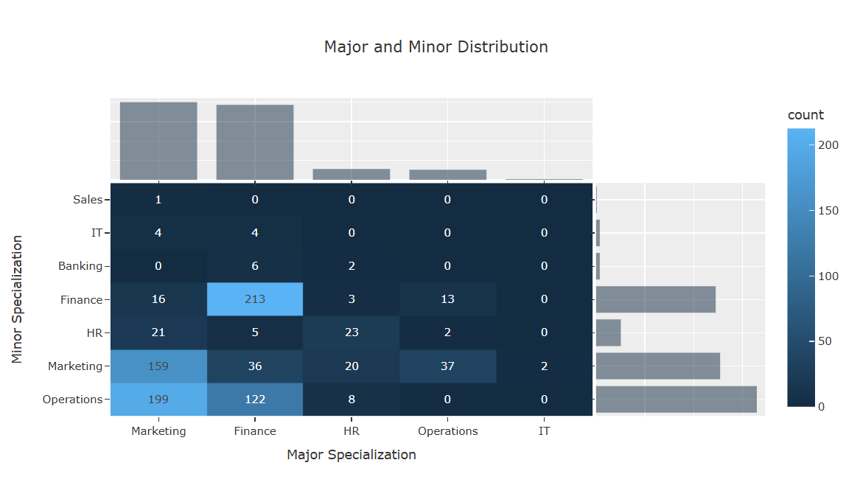
Phoenix Global Student Training Insights Case
Visualization and Insights (Program Demographic)
The density heatmap of the dataset shows distribution of Major and Minor Specialization of students.
Majority of students have opted for Marketing as their Major with minor in Marketing or Operations.
This density is also followed by students majoring in Finance with minor in Finance or Operations.
Least number of students have opted for HR, Operations or IT as their major, decreasing in that order.
As for the minors, Banking, IT and Sales have the lowest populace, decreasing in that order.

Slide 7
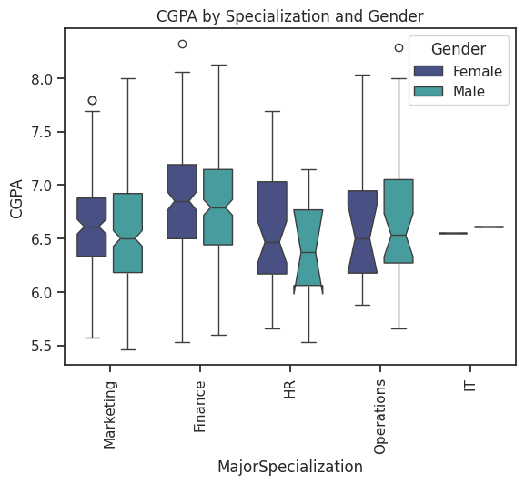
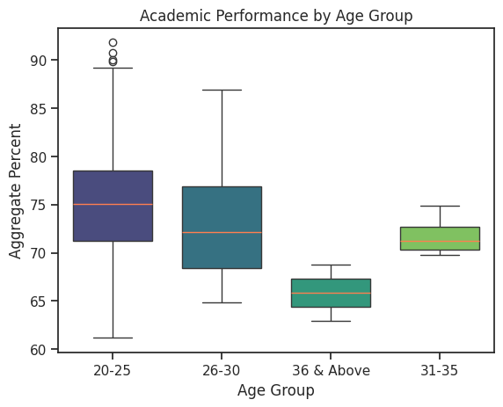
Phoenix Global Student Training Insights Case
Visualization and Insights (Program Demographic)
From the boxplot, one can determine that the CGPA of students pursuing different majors, usually ranges from 6 to 7, with very few among them being above 8.
Aggregate Percent is numeric value assigned after considering students’ full academic performance. The boxplot indicates that the age group of 20-25 has the higher academic performance than others.

Slide 8
Phoenix Global Student Training Insights Case
Results & Conclusion
Student Demographics:
Majority of students are aged 22-25 years (density: 0.35),Over 800 students have 0-2 years of work experience (entry-level) and minimal representation of students with over 4 years of experience.
Program Demographics:
57.8% Male (518 students) amd 42.2% Female (378 students) are enrolled in the programs with Marketing and Finance lead as top choices and Operations and HR see relatively fewer students.
Performance Trends:
Most students' CGPA ranges between 6.5 and 7.5 and higher academic performance observed in students aged 20-25.
Recommendations:
The recommendations for skills upgradation for every students who is part of the MBA Program can be done based on the use of Major Specialization and Work Experience .
Students with 0-2 Work Experience are in Entry Level Category, 2-4 are being considered Associate level and students more than 4 years of work experience are in Senior Level.
Since, Phoenix Global offers multiple opportunities to upgrade skills,the entry level students will be offered On the Job Training Programs, associate level students will focus on enhancing technical expertise and mid level will do leadership and strategic thinking programmes along with necessary certification programmes.
Example: For IT and HR majors, provide entry-level students with foundational technical or HR skills training, associate-level students with certifications like AWS or SHRM-CP, and mid-level students with leadership and strategic development programs tailored to their fields.

Slide 9
Phoenix Global Student Training Insights Case
Results & Conclusion
The following table shows the suggestions to Finance, Marketing & Operations majors based on their experience level:
Major | Experience Level | Suggestions
Finance | Entry Level | Basics of financial modeling, Excel for finance professionals
Finance | Associate Level | Certified Financial Analyst (CFA) Level 1, Advanced Excel for financial analysis.
Finance | Senior Level | Advanced Financial Risk Management, Portfolio Management Certification.
Marketing | Entry Level | Introduction to digital marketing, branding basics.
Marketing | Associate Level | Google Ads Certification, HubSpot Content Marketing Certification.
Marketing | Senior Level | Brand Management Strategy, Customer Experience Design.
Operations | Entry Level | Lean Six Sigma Yellow Belt, supply chain basics.
Operations | Associate Level | Lean Six Sigma Green Belt, Advanced Supply Chain Analytics
Operations | Senior Level | Lean Six Sigma Black Belt, Advanced Operations Strategy.

Slide 10

Phoenix Global Student Training Insights Case

